Slide 1
Nigeria Debt%GDP & Unemp. Rate(1990 - now) - OMDENIA
File created on: 7/2/2024 11:08:50 PM

Slide 2
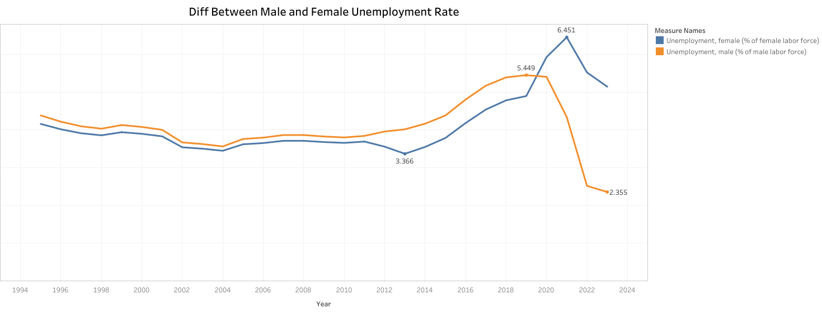

Slide 3
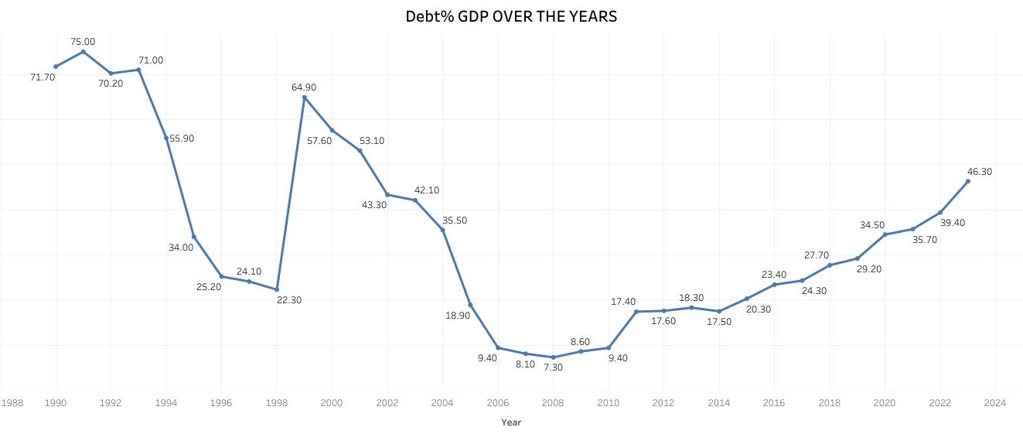

Slide 4
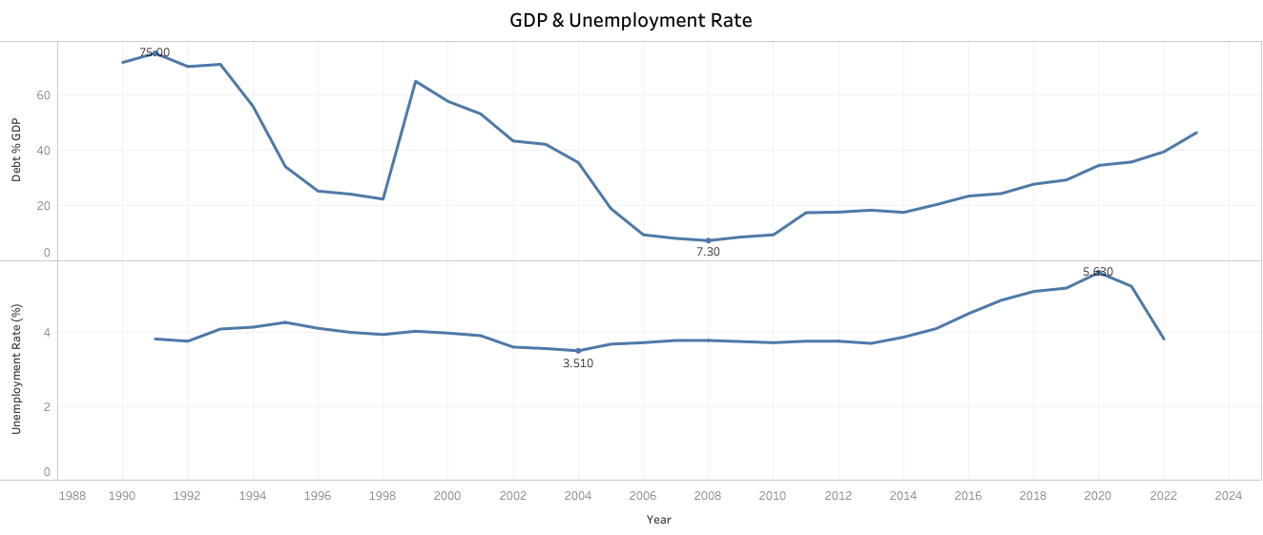

Slide 5
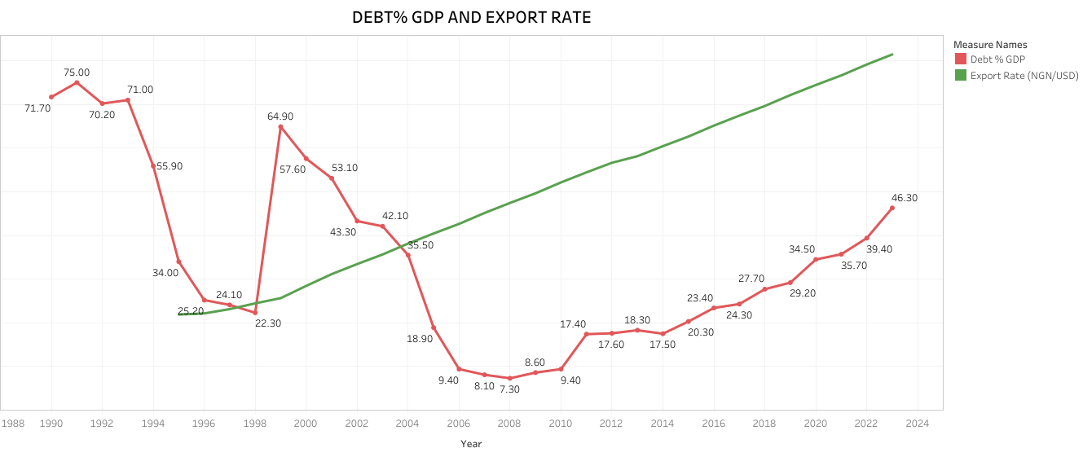

Slide 6
